Slide 1


Mac Admins India
Device Compliance Migration
Tech Deep Dive
Shyam Sundar | 20-April-24

Slide 2

Remembering Charles Edge
35 Years of experience as developer, administrator, network architect, product manager, entrepreneur and CTO.
Author of 20+ books and 6000+ blogs
Author of Krypted.com
Founder and Co-host of MacAdmins Podcast
Co-host of Jamf After Dark Podcast

Slide 3

Agenda
What is Conditional Access
Why to Migrate
How to Migrate
Verify the Migration

Slide 4
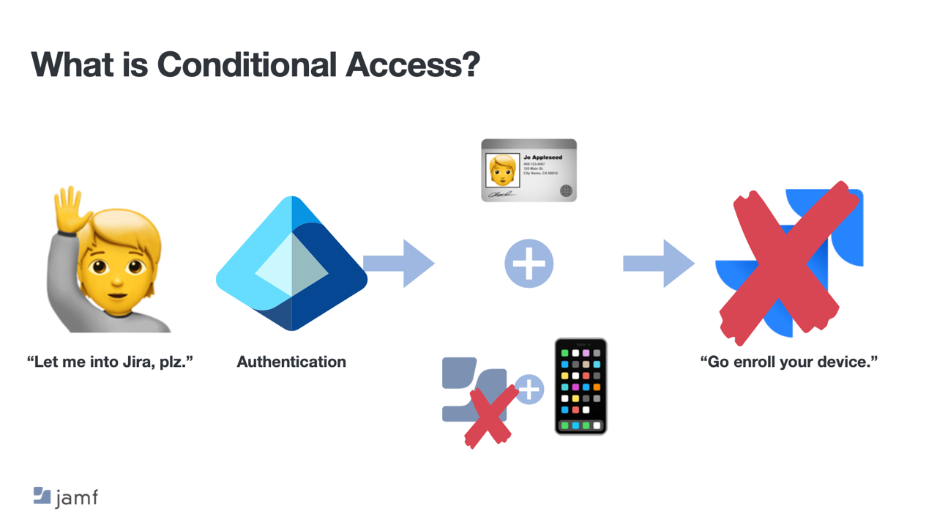


Slide 5
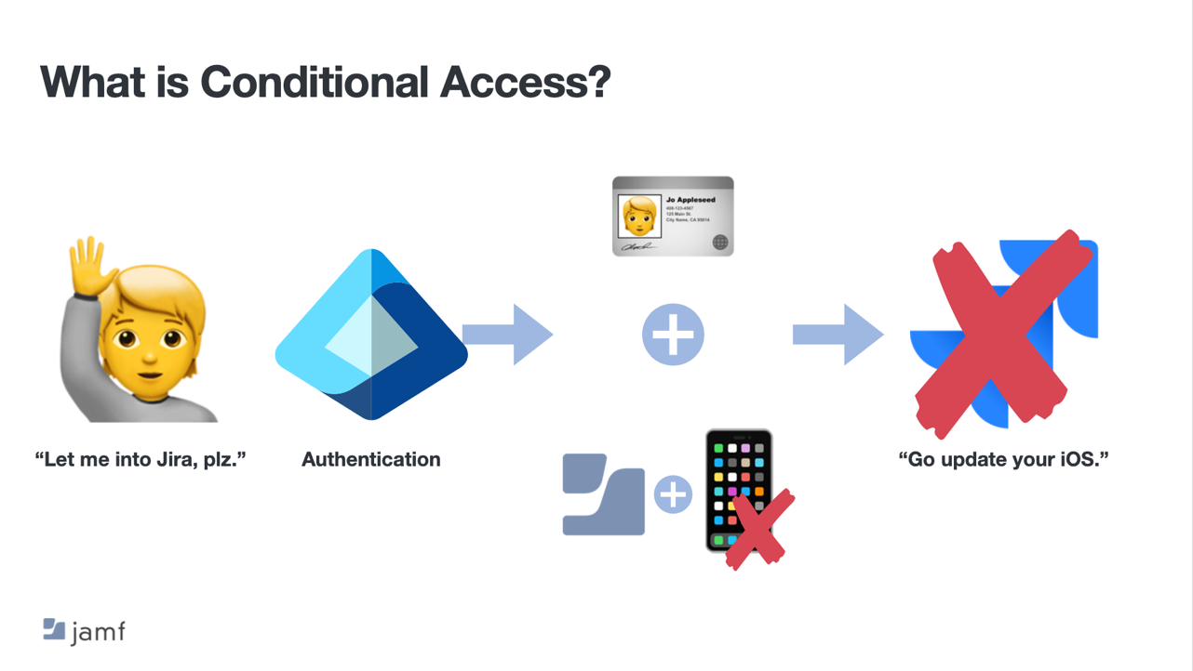

Slide 6
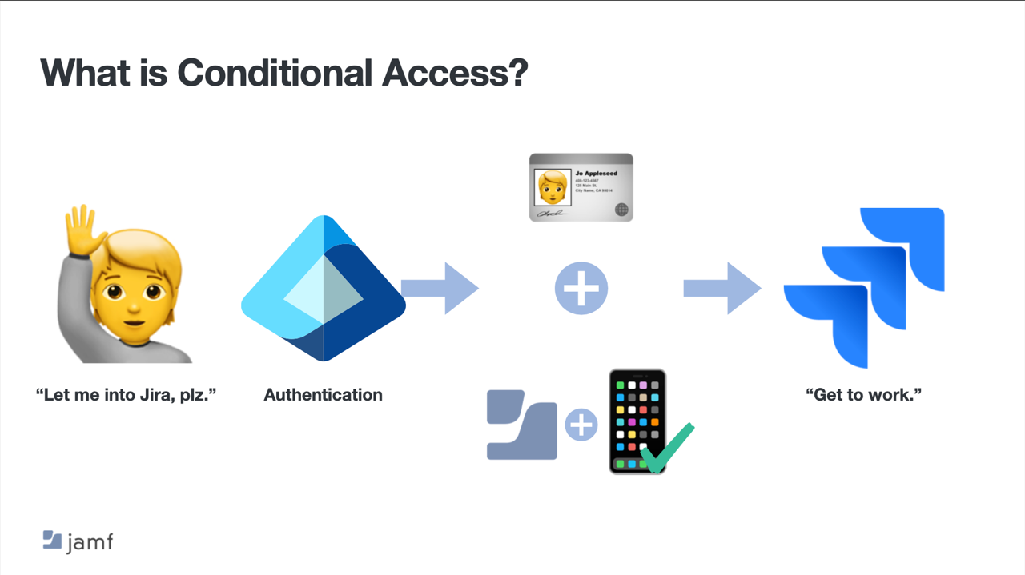

Slide 7

Why to Migrate

Slide 8

Why to Migrate
Transitioning to Partner Compliance Management API.
Legacy Conditional Access API support ends September 1, 2024.
Embrace macOS Device Compliance with the new API.
Smooth migration paths are available.
Legacy API operational until the 2024 deadline.
Notes:
The transition from Microsoft's Partner Device Management legacy API to the new Partner Compliance Management API is necessary for continued support. The legacy API will no longer have support for Conditional Access after September 1st, 2024. The new API provides a future-proof solution with enhanced security and integration with macOS Device Compliance. Organizations can now migrate smoothly from the old API to the new one and the timeline for this migration is until September 1st, 2024.

Slide 9
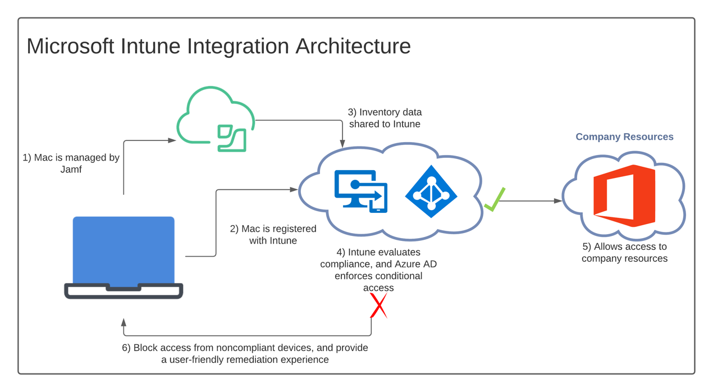

Slide 10
JAMF Pro attributes Used for Compliance
Attribute | Intune API Key | JAMF inventory
Tenant ID | TenantID | N/A
Device AAD ID | Device ID | Local User Accounts category: Computer Azure Active Directory ID
JAMF Inventory State | State | Calculated 0 == activated in Jamf Pro (new or coming back from unresponsive); 1 == deactivated (deleted/retired from Jamf Pro); 2 == unresponsive (time of last recurring check-in is more than 24 hours ago)
OS Version | OSVersion | Operating System category: Operating System Version
User AAD ID | UserID | Local User Accounts category: User Azure Active Directory ID
# of previous password to prevent reuse | Password History Length | Local User Accounts category: Password History
Encrypted (FileVault 2) | Yes | Disk Encryption category: Boot Partition: FileValult 2 Partition Encryption State
Gatekeeper | No | Security category: Gatekeeper
Minimum # of character sets | Yes | Local User Accounts category: Minimum Number of Complex Characters
Password expiration (days) | Yes | Local User Accounts category: Maximum Passcode Age
Password Type | Yes | N/A
Prevent Auto Login | Yes | Security category: Disable Automatic Login
Required Passcode Length | Yes | Local User Accounts category: Minimum Passcode Length
System Integrity Protection | Yes | Security category: System Integrity Protection FALSE = not collected status (could happen on first enrollment or very recent upgrade of Jamf Pro agent) or Disabled status; NOTAPPLICABLE is displayed for a macOS version earlier than macOS 10.11

Slide 11
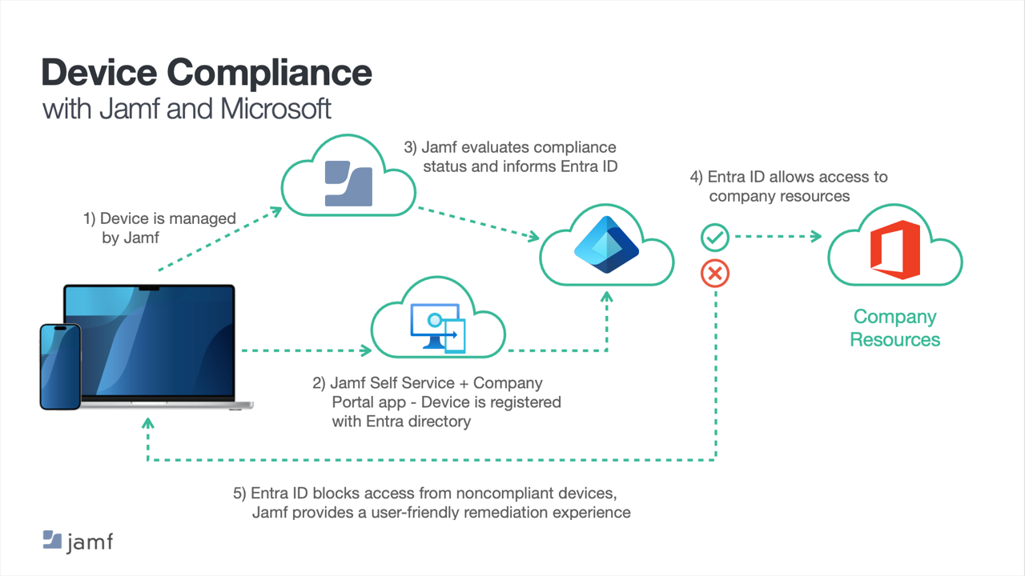

Slide 12
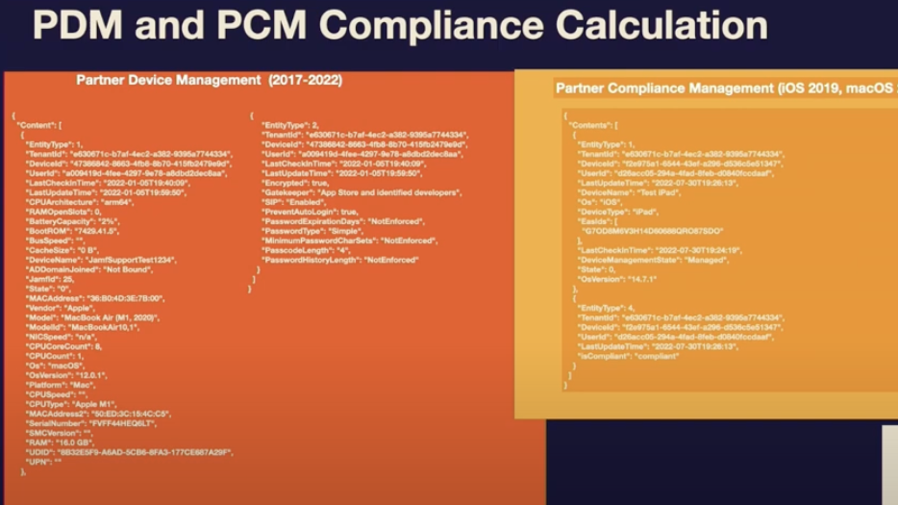

Slide 13
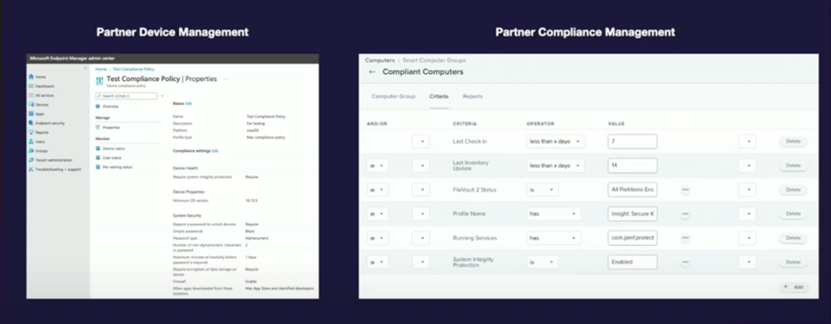

Slide 14

How to Migrate

Slide 15

Prerequisites
Before beginning the migration to the new macOS Device Compliance, ensure the following requirements are met:
Cloud-Hosted Environment:
The macOS Device Compliance migration is available for JAMF Pro cloud-hosted environments.
JAMF Pro Version:
Ensure your JAMF Pro instance is updated to version 10.48.0 or later for compatibility with the migration process.
Compliance Smart Group :
This group should contain the computers that must meet specific criteria to be considered compliant
Entra Administrative Access:
You must have a Microsoft Entra ID account with global or domain administrator rights.
Entra ID user group:
This group should contain all the users who can do the device registration.

Slide 16
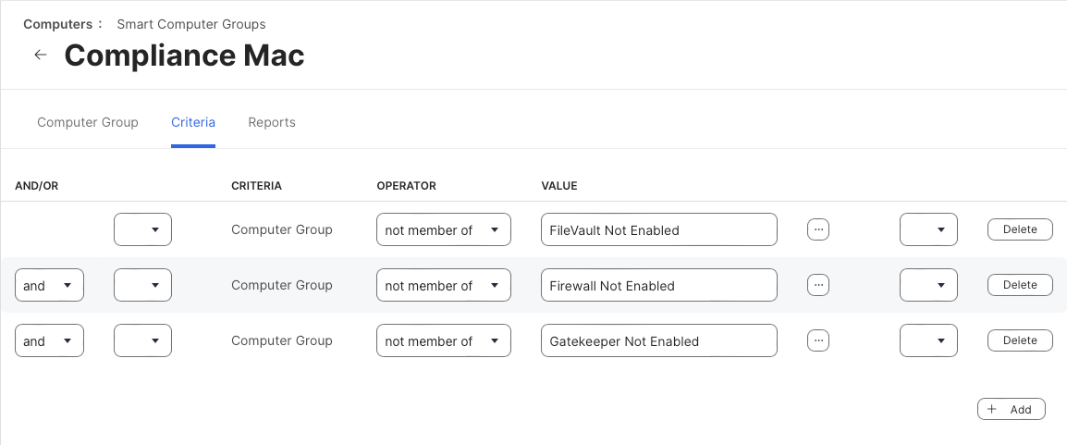
Compliance Group

Slide 17
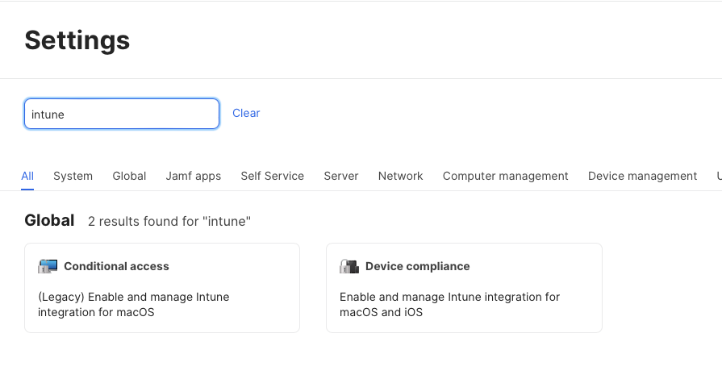

Slide 18
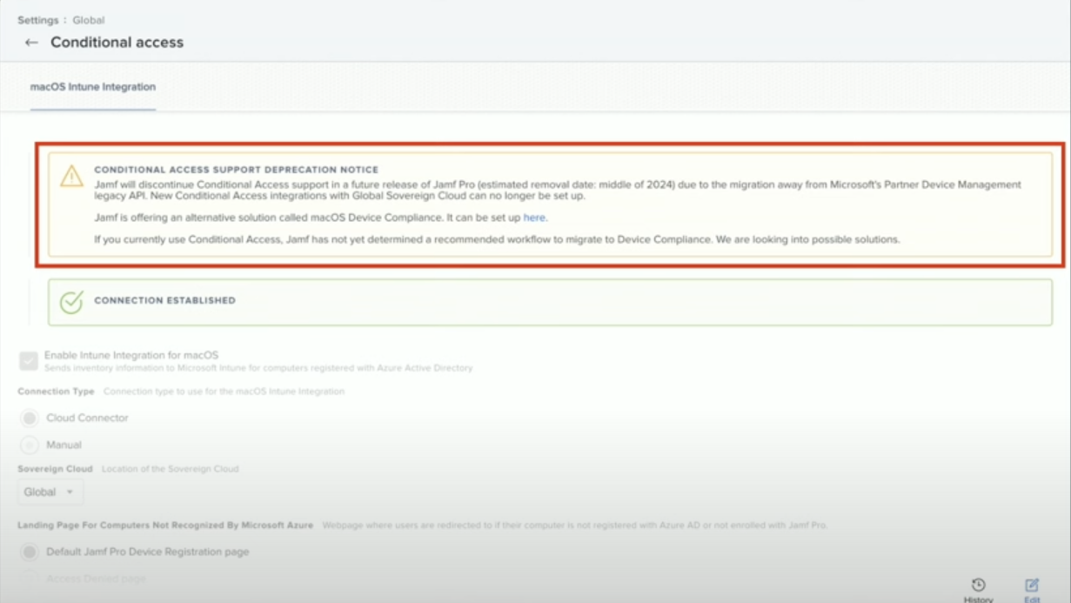
Disable the Conditional Access integration in JAMF Pro

Slide 19
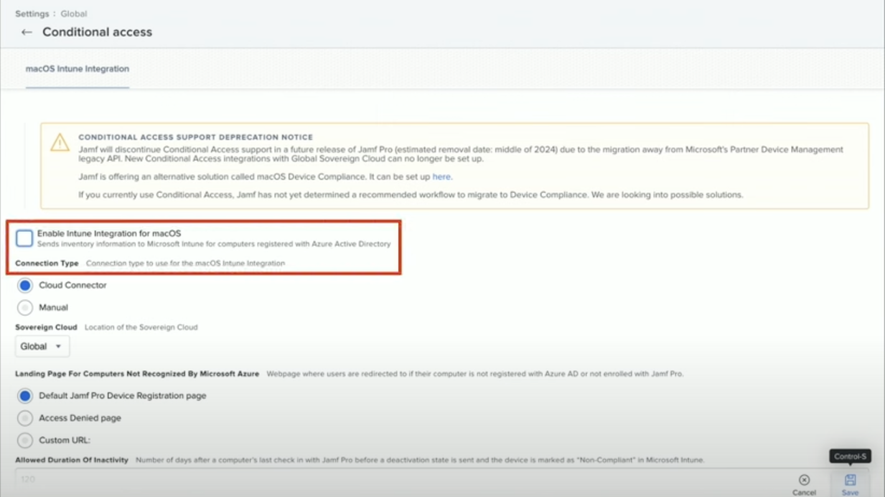

Slide 20
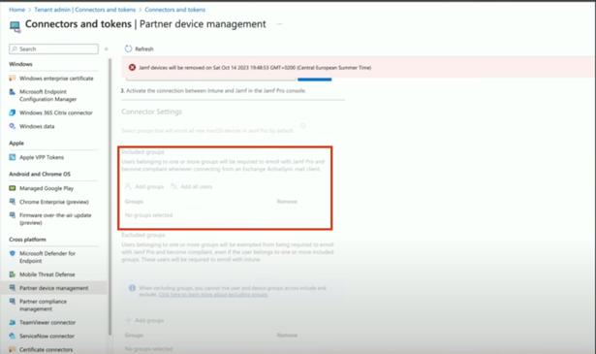
Disable Partner Device Management
Remove target users from the Partner Device Management scope in Microsoft Intune.
Note: Users cannot be scoped for both Partner Device Management and Partner Compliance Management when registering or re-registering new computers with Device Compliance.
Log in to Microsoft Intune.
Navigate to Tenant administration > Connectors and tokens > Partner device management.
Under Included groups, remove all groups that include users you want to migrate to Device Compliance.
Click Save.

Slide 21
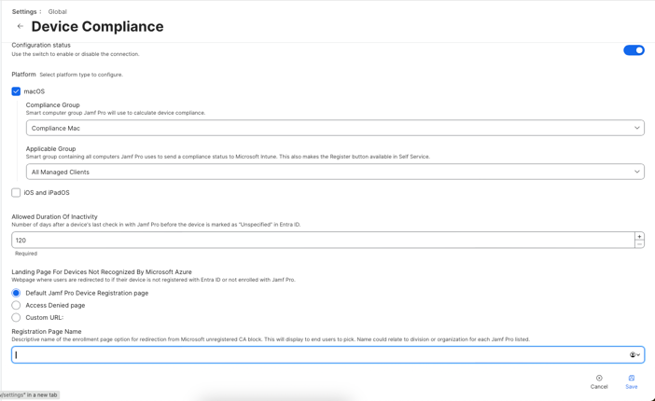
Enable Device Compliance
In Jamf Pro, click Settings in the sidebar.
In the Global section, click Device compliance
Click Edit .
Use the switch to enable the integration.
Choose your platform type as Mac
Choose the Compliance Group you want Jamf Pro to use to calculate device compliance.
Choose the Applicable Group you want Jamf to use to send compliance status to Microsoft Entra.
Select the following landing page options for devices that are not recognized by Microsoft Entra ID: The default Jamf Pro Device Registration page
Click Save .

Slide 22
Creating a Compliance Partner in Entra
Click on Open Consent URL
Enter Entra ID credentials and follow the onscreen instructions to grant the permissions requested by Microsoft.
Click Open Microsoft Endpoint Manager
Click Add compliance partner.
Choose "JAMF Device Compliance" from the Compliance partner pop-up menu.
Choose the platform as macOS from the Platform pop-up menu and click Next.
Click Add Groups and choose the Entra ID user groups you want to use from the Select groups to include pop-up menu.
Click Select and then click Next.
Review your configuration and then click Create.
Navigate back to the JAMF Cloud Connector tab and click Confirm
The success or failure of the connection displays on the Device Compliance settings page.

Slide 23
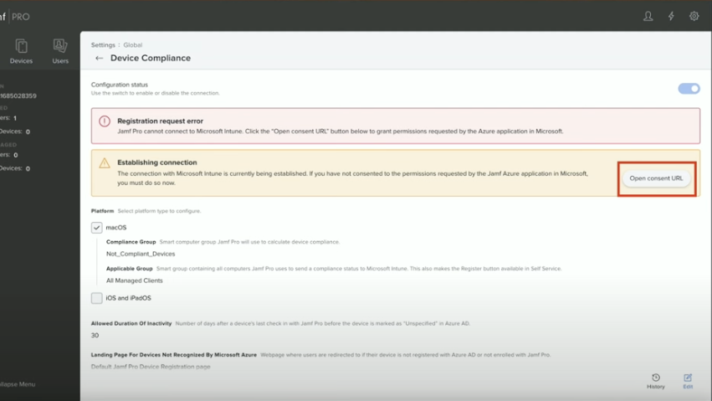

Slide 24
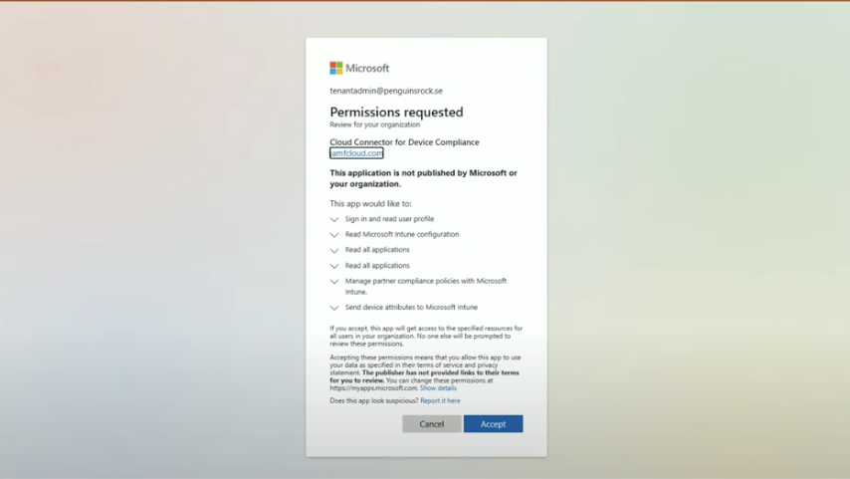

Slide 25
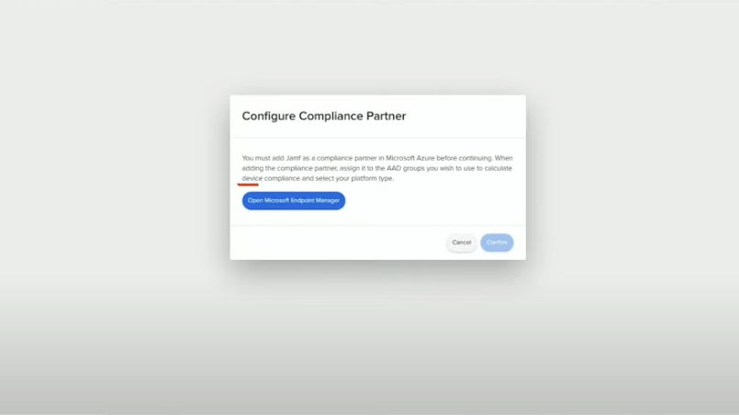

Slide 26
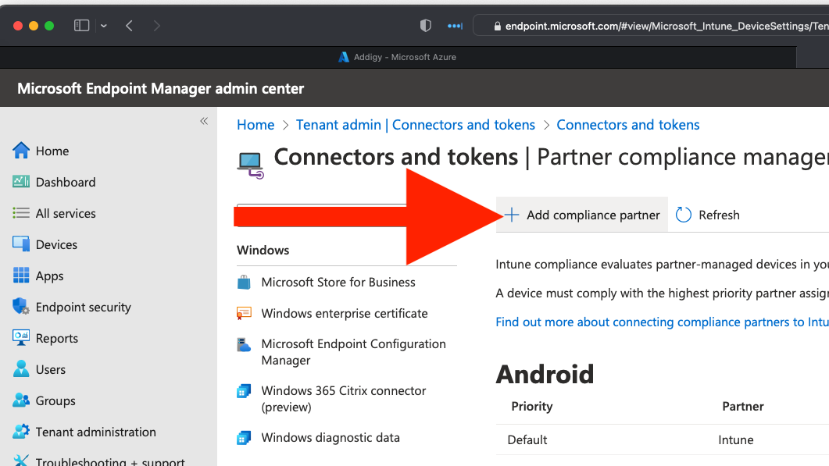

Slide 27
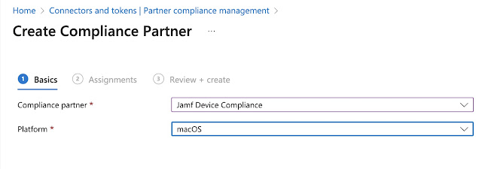

Slide 28
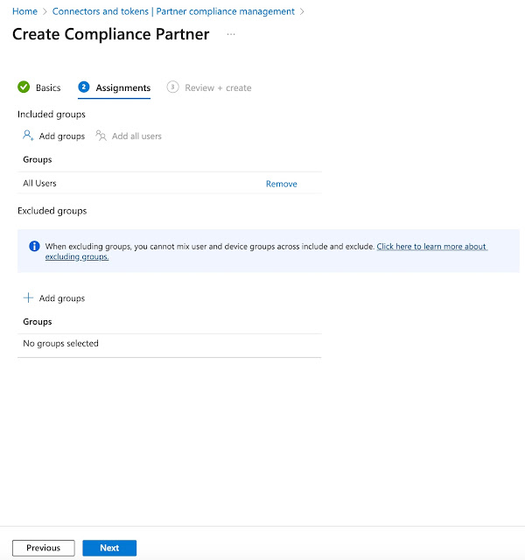
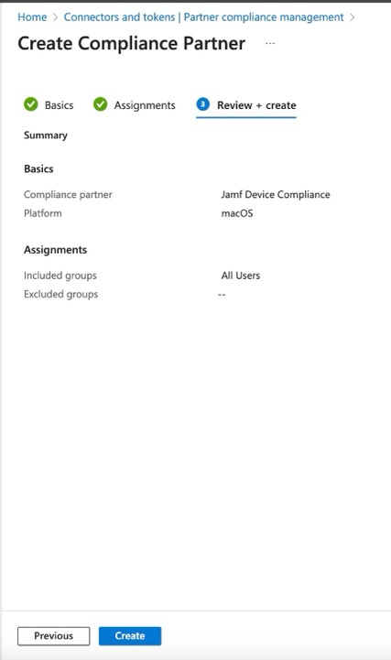

Slide 29
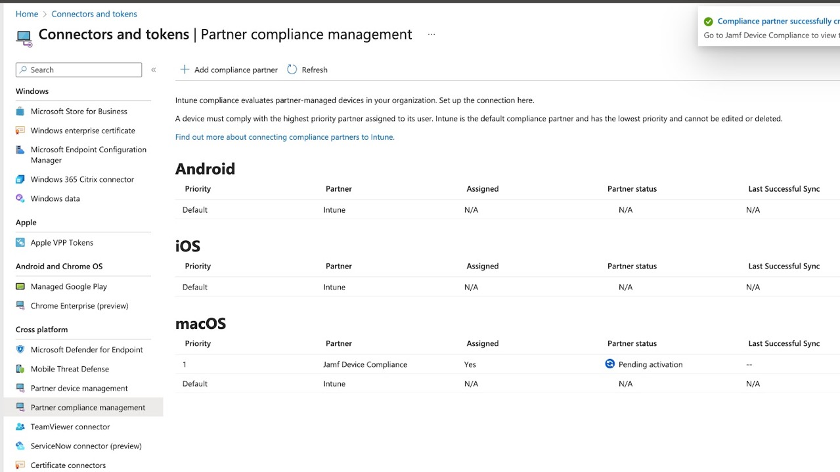

Slide 30
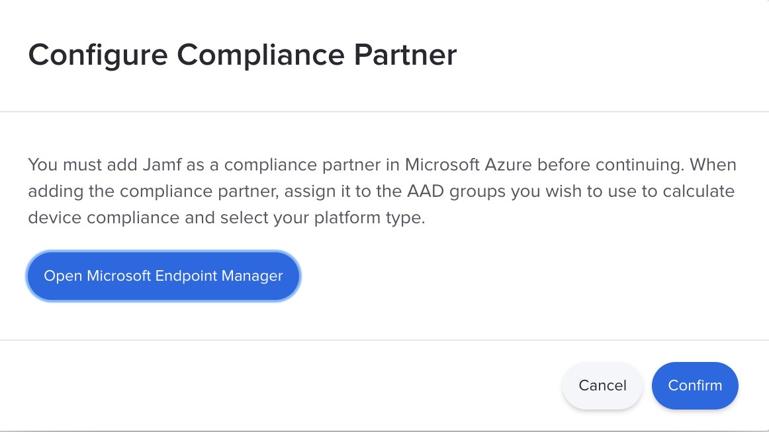

Slide 31
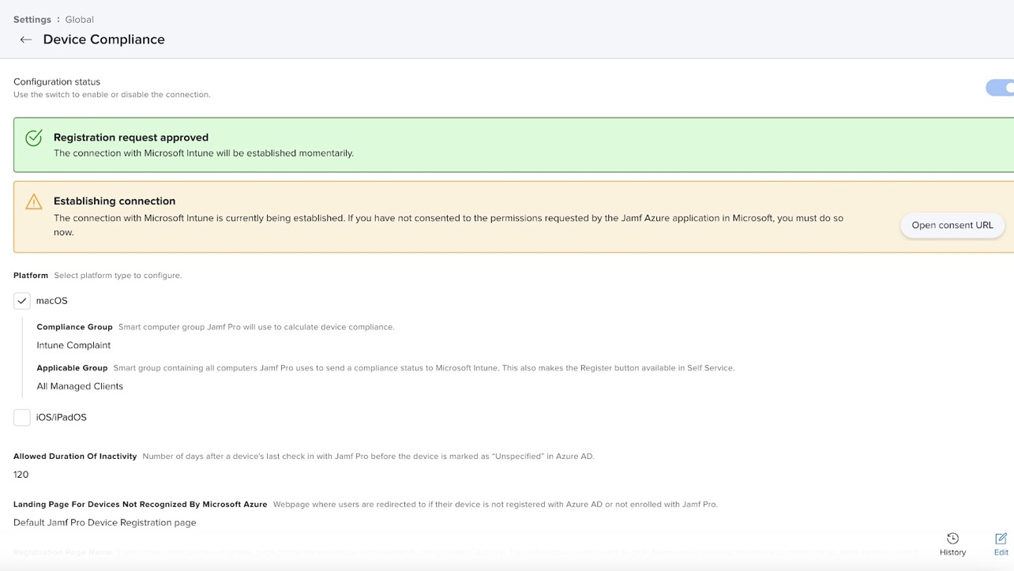

Slide 32
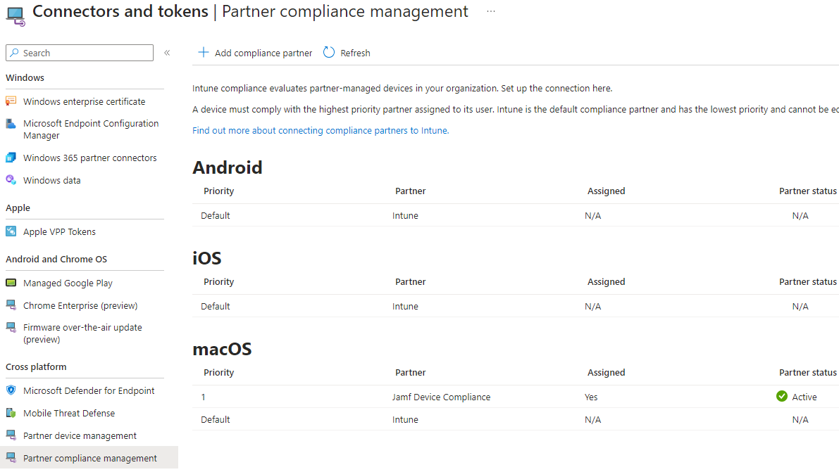

Slide 33

Verify Migration

Slide 34
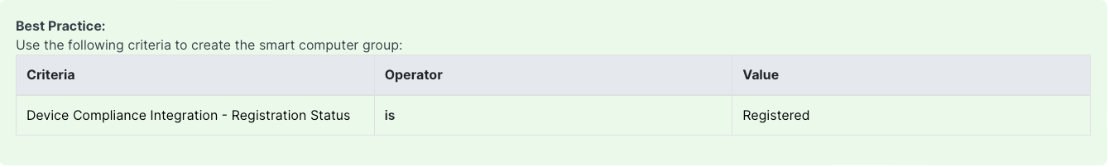
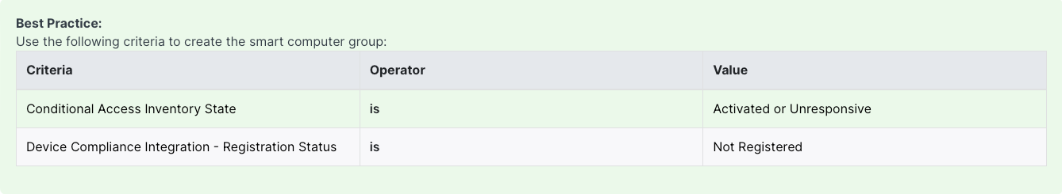
Create a smart computer group to view Migration status
Devices will be migrated to the Device Compliance integration after JamfAAD information has been collected and sent to Jamf Pro.
To Find Device Migrated
To Find Device Yet to Migrate

Slide 35


Slide 36
Key Considerations for Post-Migration
All Intune entries previously visible will be removed following the migration.
The JAMFAAD prompt will no longer appear if Single Sign-On (SSO) profiles are deployed to your devices.
The macOS Intune Integration logs found in the History tab will be void of entries for devices registered after the migration.
Attributes such as Computer AAD ID, User AAD ID, and Conditional Access inventory state will no longer display in the Local User Account tab.
Any smart groups utilizing Conditional Access Inventory State criteria will cease updating calculations post-migration.
It is critical to disable Conditional Access and enable Device Compliance simultaneously to maintain consistent policy enforcement.
Multiple Cloud instance can be integrated with Single Entra ID.

Slide 37

Any questions

Slide 38

Join us here
Scan this QR code to join our community

